Slide 1
Modeling Newton’s Universal Law of Gravitation
*with REAL astronomical data!*
Lucas Walker, AAPT Summer Meeting 2017
Weston High School - Weston, CT

Slide 2
Goals
Provide background on NGSS requirements relating to Newton’s Universal Law of Gravitation.
Demonstrate a phenomenon-based entry point, inquiry-focused investigation, and method for students to develop a quantitative model for gravity.
All in 8 minutes! Buckle Up!

Slide 3
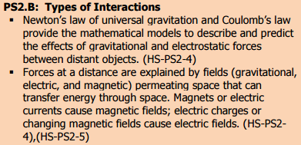
NGSS Framework
No problems here! This is content which is traditionally covered in an introductory physics course, for sure.

Slide 4
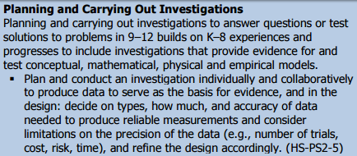
NGSS Framework
Wait – my students need to do an EXPERIMENT about Newton’s Universal Law of Gravitation?
Analyze and interpret data? I don’t know about you but my school doesn’t have an observatory, and I’m not Henry freakin’ Cavendish over here!

Slide 5
NGSS Framework
Um, computational thinking? Isn’t that programming? I wasn’t trained for this!
Students need to construct an EXPLANATION? Hypotheses non fingo!

Slide 6
Modeling Pedagogy – modelinginstruction.org
Student-centered, inquiry driven
The steps:
Ask questions & define variables
Collect data, plot it, and find a mathematical relationship
Interpret constants and generalize
Test model & refine as necessary until it breaks!!

Slide 7
Ask Questions & Define Variables
BEFORE tackling Newton’s Universal Law of Gravitation, we have already discussed the following:
Mass vs. weight, gravitational intensity on Earth is 9.8 N/kg but is different on other planets – NASA videos
Objects in free fall near Earth experience a = 9.8 m/s per second, and this is not a coincidence but explained with N2L.
Objects undergoing uniform circular motion have nonzero acceleration, and we can calculate the magnitude of the acceleration with a = v²/r. N2L still applies to acceleration of this type, so we can infer a centrally directed force proportional to the acceleration of such an object.

Slide 8
Ask Questions & Define Variables
Good practice with circular motion: look up orbital characteristics of the ISS and find its acceleration.
Wait a minute – it’s only 9.1 m/s per second? I thought “Earth’s Gravity” gave all objects an acceleration of 9.8?
What does this mean about the FORCE the ISS is experiencing in its orbit vs. the force it would experience on Earth?
What might cause the gravitational intensity to be weaker?

Slide 9
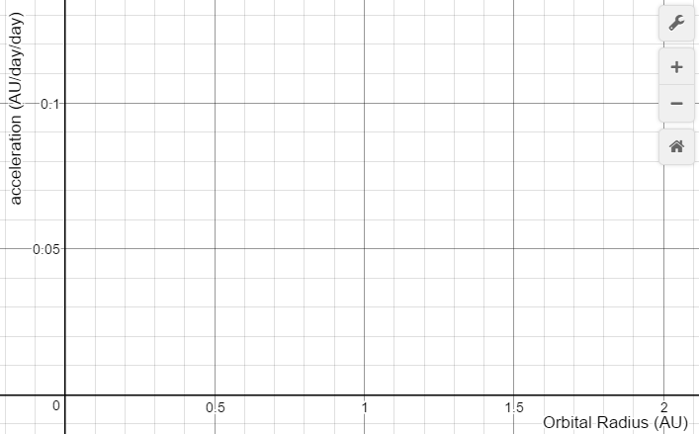
Ask Questions & Define Variables
We are given the impression that gravitational intensity gets weaker the further we get from a given planet. What kind of GRAPH would show this relationship?
Gravitational Intensity vs. Orbital Radius

Slide 10
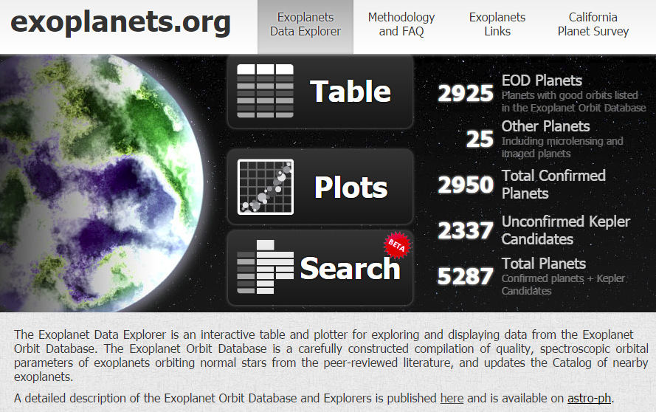
Collect Data, Plot It, and Model

Slide 11
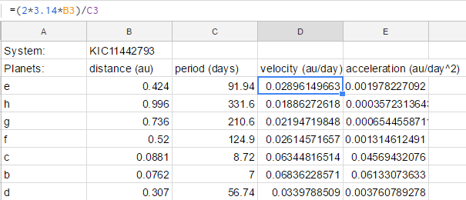
Collect Data, Plot It, and Model
Search systems with 5 or more objects
Record orbital radius and orbital period for each object
Students use uniform acceleration equations to calculate acceleration = gravitational intensity.
Repeated calculations is a great opportunity to use a spreadsheet and do some programming! Use as many steps as is appropriate for your students!

Slide 12
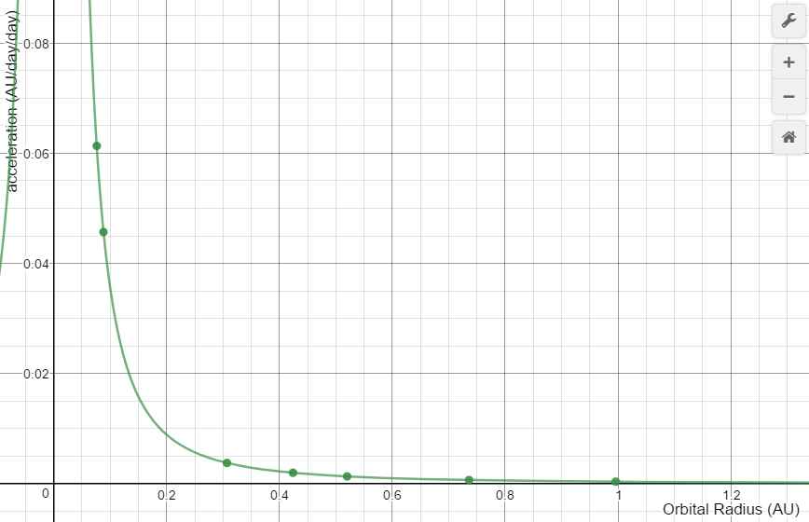
Collect Data, Plot It, and Model
Plot gravitational intensity vs. radius
Conclude that acceleration of a planet is inversely proportional to the square of its orbital radius.
(I know I am cheating and I don’t care – with my Honors class I did a side project about how Kepler actually figured this out.)
**Desmos Graphing Calculator is your web-based data analysis solution!**

Slide 13
Interpret Constants and Generalize
We now have 6-8 sets of data on solar systems whose planets all follow the relationship g = b/r² where b is a constant
Multiplying both sides by mass of planet m would give F = b(m/r²)
What could the constant represent – what else affects gravitational force?
Provisionally then we go with F = Mm/r². This equation both reflects everything we qualitatively understand about how gravity works AND our quantitative data from exoplanets.

Slide 14
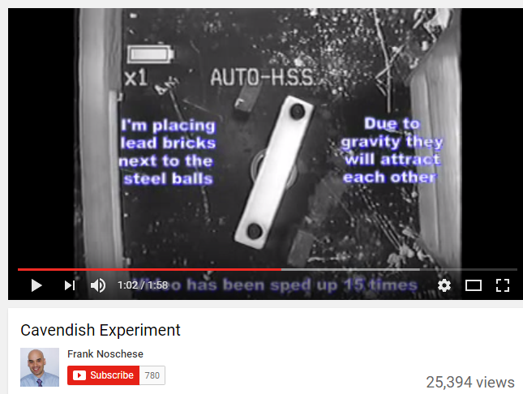
Test Model
Plug in some known values and calculate the gravitational force that SHOULD be felt by some pairs of objects in your classroom.
Something is wrong with our equation! Now is a good time to bring up Cavendish.
(This is my fave video because it’s qualitative and clear. Thanks Frank! https://www.youtube.com/watch?v=dyLYbvZIYoU)

Slide 15
Did we address our NGSS Framework?
After all that, students should REALLY understand what it means that NULG is a mathematical model!
I’d come back to the field thing after we find that Coulomb’s Law follows a similar mathematical model.

Slide 16
NGSS Framework
Check! We discussed the kind of data we would need, located it and processed it to make it useable for our purposes.
Yep! We used an inverse-square model to match our data, and we interpreted the meaning of the constant.

Slide 17
NGSS Framework
Yes! Not only did we use our circular motion models to enable data analysis, but we also used rudimentary programming skills to quickly process a large amount of data in a spreadsheet (computation)!
Students grapple with the meaning of the inverse-square force law as a relationship that was FOUND in data, not given from a book, and are faced with the same fundamental weirdness that led Newton to famously NOT propose an explanation! I don’t know, have them write a paragraph about it! Content-area literacy connections?

Slide 18
Known Issues With This Sequence
Students do struggle with formulating the experiment in the first place. Using circular acceleration as a proxy for measuring gravitational force is a little tricky, conceptually.
The calculations are eased by the use of the spreadsheet but can also trip students up. Using units of AU for distance and days for time makes it easier to process the data directly from the database but leads to very small accelerations.
Inquiry takes time! My school has ~1 hr periods:
1 period to pose question and design experiment
1 period to find data and process it
1 period to graph, find relationship, write equation & discuss
1 period to test relationship and talk about Cavendish
Additional time to do practice problems with the finished Universal Law of Gravitation as needed.
Your mileage may vary.

Slide 19
Very Many Thanks To:
Exoplanets.org
AMTA & modelinginstruction.org – I didn’t use any of their materials to come up with this but my approach was very much shaped by Modeling Pedagogy
Anna Balouskus – worked to develop this for classroom deployment this year, came up with a really cool extension where students make some calculations about gravitation, year length, etc. on various exoplanets and make a tourism poster – but it needs more work :D
It is easier to innovate when your curriculum partners & department chair are so supportive!
Connect on Twitter!
@RealMrSkyWalker

